Slide 1
COS 212 7.2: Tries
Presented by Dr Anna Bosman

Slide 2
Trees & Prefixes
Most m-way trees that we considered stored entire keys in their nodes
When searching for a specific key, you would compare this key to other keys stored in the tree, until the key is found
Prefix B+-trees and Bit-trees illustrated that storing an entire key is not necessary, and you can get away with storing only the prefixes or the D-bits to guide the search
However, maintaining prefixes after insertion/deletion can become complicated
insert
“bell”
J
…
B | D
bell ?
and | ant | aunt
bar | bard | bear
dog | door

Slide 3
Tries
Another m-way tree data structure
From “retrieval”, but pronounced as “try” to avoid confusion
Instead of storing the keys or prefixes directly, primitive building blocks that make up the prefixes are stored
Building blocks of strings = characters
Every root-to-leaf path in a trie “constructs” a key prefix from the building blocks
Prefix or key is not stored in a node – it is stored in a path
1st character
A | B | D
2nd character
N | U
A | E
O
3rd character
D | T
N
R
A
G | O
4th character
T
D
R
R

Slide 4
Implementing Tries
Let’s start with a simple example – suppose the alphabet consisted of only these letters: A B D E R
To keep the structure simple, we will make every node of a fixed size: 5, to contain all available characters
Every character will have a pointer attached to it: null if no word corresponds to the combination, not null otherwise
A | B | D | E | R
A | B | D | E | R
A | B | D | E | R
A | B | D | E | R
A | B | D | E | R
A | B | D | E | R
A | B | D | E | R
A | B | D | E | R
EBB
A | B | D | E | R
EAR
BAD
BAR
BEAR
BED
BEER
DEAD
DEER
R
EAD
R
ED

Slide 5


Implementing Tries
Non-leaf nodes are the “index set” – we only need them to guide the search
Leaf nodes contain valid words
Searching a trie: follow the prefix till you find a leaf; compare key
Search for “BEAR”
What about “BEER”?
Prefix of BEER – BEE – is also a valid word – how can we store it?
A | B | D | E | R
A | B | D | E | R
A | B | D | E | R
A | B | D | E | R
A | B | D | E | R
A | B | D | E | R
A | B | D | E | R
A | B | D | E | R
EBB
A | B | D | E | R
EAR
BAD
BAR
BEAR
BED
BEER
DEAD
DEER
R
EAD
R
ED

Slide 6
Implementing Tries
Use a special character to represent the end of the word
In the example below, # is the chosen “end of word” character
Now we can store both BEER and BEE
A | B | D | E | R | #
A | B | D | E | R | #
A | B | D | E | R | #
A | B | D | E | R | #
A | B | D | E | R | #
A | B | D | E | R | #
A | B | D | E | R | #
A | B | D | E | R | #
EBB
A | B | D | E | R | #
EAR
BAD
BAR
BEAR
BED
A | B | D | E | R | #
DEAD
DEER
R
EAD
R
ED
BEER
BEE

Slide 7
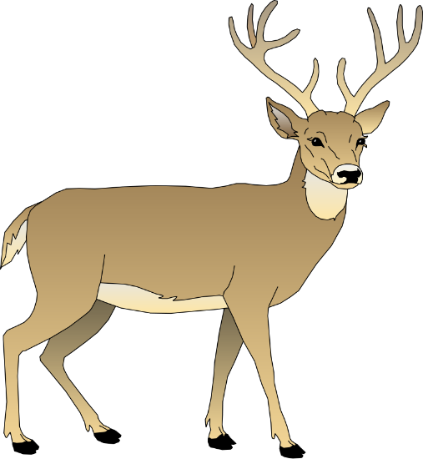
Implementing Tries
If the prefixes are already stored in the tree, do we really have to store the entire words in the leaves?
No – instead, you can store the suffixes only:
Can you think of a good application for the trie data structure?
Spellchecker, automatic word completion
A | B | D | E | R | #
A | B | D | E | R | #
A | B | D | E | R | #
A | B | D | E | R | #
A | B | D | E | R | #
A | B | D | E | R | #
A | B | D | E | R | #
A | B | D | E | R | #
B
A | B | D | E | R | #
R
R
A | B | D | E | R | #
D
R
D

Slide 8
Tries: Insert
Start from the root;
Search for the word to be inserted (W) in the trie
If node[i] == null, create a leaf for W and store in node[i]
insert “RED”
A | B | D | E | R | #
R
ED
A | B | D | E | R | #
A | B | D | E | R | #
A | B | D | E | R | #
A | B | D | E | R | #
A | B | D | E | R | #
A | B | D | E | R | #
EBB
EAR
BAD
BAR
BEAR
BED
A | B | D | E | R | #
DEAD
DEER
BEER

Slide 9
Tries: Insert
Else, if end of word is reached before reaching a leaf:
Create a leaf for W and store in node[#]
insert “BEE”
A | B | D | E | R | #
R
ED
A | B | D | E | R | #
A | B | D | E | R | #
A | B | D | E | R | #
A | B | D | E | R | #
A | B | D | E | R | #
A | B | D | E | R | #
EBB
EAR
BAD
BAR
BEAR
BED
A | B | D | E | R | #
DEAD
DEER
BEER
BEE

Slide 10
Tries: Insert
Else, if leaf node is reached, and leaf != W
While W[i] == Leaf[i]
create non-leaf node, link to current node
i++
Insert W and Leaf into the last non-leaf created
insert “READ”
R E D
A | B | D | E | R | #
R E A D
R
ED
A | B | D | E | R | #
A | B | D | E | R | #
A | B | D | E | R | #
A | B | D | E | R | #
A | B | D | E | R | #
A | B | D | E | R | #
A | B | D | E | R | #
EBB
A | B | D | E | R | #
EAR
BAD
BAR
BEAR
BED
A | B | D | E | R | #
DEAD
DEER
R
EAD
R
ED
BEER
BEE

Slide 11
Tries: Efficiency
Height of the trie == longest common prefix + 2 (why?)
In the English language: ~7
Height of a BST for 10 000 English words: 14, 100 000 words: 17
A | B | D | E | R | #
A | B | D | E | R | #
A | B | D | E | R | #
A | B | D | E | R | #
A | B | D | E | R | #
A | B | D | E | R | #
A | B | D | E | R | #
A | B | D | E | R | #
EBB
A | B | D | E | R | #
EAR
BAD
BAR
BEAR
BED
A | B | D | E | R | #
DEAD
DEER
R
EAD
R
ED
BEER
BEE
Longest common prefix: BEE (3)
+ node to diff “bee” and “beer” (1)
+ leaf nodes (1)

Slide 12
Tries
Problem with tries: wasted space
Most nodes will only use a few of their pointers (27 in total if the entire alphabet is used)
Solution?
Store only the characters that lead to other nodes/leaves
flexible size nodes: use a linked list instead of an array
B | D | E | R
A | E
E
A | B
E
D | R
A | D | E
A | E
A | D
EAR
EBB
BAD
BAR
BEAR
BED
R | #
DEAD
DEER
R
EAD
R
ED
BEER
BEE
A
D

Slide 13
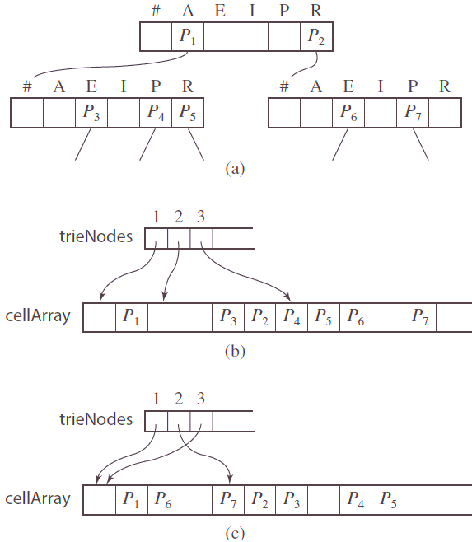
Compressing Tries
Tries “a tergo”:
Insert words in reverse (instead of inserting “beer”, insert “reeb”)
Why: because common prefixes lead to deeper tries
Flaw: common suffixes (-ality, -ing, -ism)
Compressing tries
Instead of storing a separate array of references for each node, put all references into a single large array
Because there are many empty spaces, nodes can “interleave”
Another array is used to store references to the specific “nodes” in the large array
Simplest interleaving algorithms are preferred

